Slide 1

Zhiyan Shi
Pokémon Case Analysis

Slide 2

Approach
Assumptions:
All the data insights are made based on the data given.
Data source:
https://www.kaggle.com/datasets/lrcusack/pokemontrainers?resource=download
Data Tables: pokemon, trainers
Set the goal: to identity the features of Pokémon owned by current trainers
Data cleaning: remove duplicates and outliers
Run Exploratory Data Analysis(EDA) based on different data questions
Build regression model
Make recommendation

Slide 3
Exploratory Data Analysis: Question Reviews
How many trainers and Pokémon are there in total?
What is the mean pokelevel of all the Pokémon? Show the distribution
What is the max maxhp of all the Pokémon? Show the distribution. What type of distribution is it?
Show the distribution of Pokémon type1. What is the most common type1? What is the least common?
Which Pokémon type1 has the highest average attack? What is the value? Which Pokémon type1 has the lowest average attack? What is the value?
Which Pokémon type1 has the highest average defense? What is the value? Which Pokémon type1 has the lowest average defense? What is the value?
How many trainers have a full team (6 Pokémon)?
How many different teams does Youngster Wyatt have? What Pokémon has the highest speed on any of his teams?
Which trainer has the most Dragon type Pokémon of level 100? How many level 100 Dragon type Pokémon do they have?
Of the pokelevel 100, which combination of type1 and type2 can bring the dragon Pokémon with the highest attack level?
Of the pokelevel 100, which combination of type1 and type2 can bring the Psychic Pokémon with the highest attack level?
Who has the most Pokémon? Please show how many Pokémon they have under different type1?

Slide 4
How many trainers and Pokémon are there in total?
Trainer table shows there are 11,860 total trainers registered in the game.
Pokemon table shows 11,443 trainers have their pokémon and there are 656 different pokémon.
417 trainers are still on their journey to find their first pokémon.

Slide 5
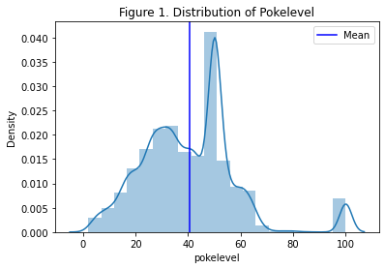
What is the mean pokelevel of all the Pokémon?
Pokelevel: the level of Pokémon and the level is between 0 and 100.
Trainers can level up their Pokémon by winning more battles and gaining more battle experience.
Statistics:
The mean of pokelevel of all the Pokémon is 40.442508.
The distribution in Figure 1 shows the number of trainers at different pokelevels.
Three peaks are found, indicating that the most pokelevel is between 40 and50, the second most pokelevel is between 20 and 40, and some of Pokémon have achieved the max level.
The distribution also indicates the difficulty of leveling up Pokémon under different ranges. It is more difficult to upgrade to the next level at a relatively higher range than at the beginning because more battle experience is needed.

Slide 6
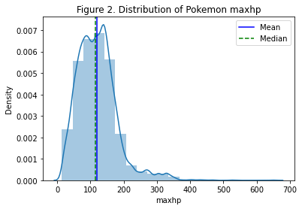
What is the max maxhp of all the Pokémon?
Statistics:
The highest maxhp of all the Pokémon is 656.
Its distribution is positive-skewed because the mean is greater than median (120 > 116), shown in the Figure 2.
Most of Pokémon are clustered between 0 and 200. It is also aligned with the distribution of pokelevel because the higher pokelevel means the higher maxhp.

Slide 7
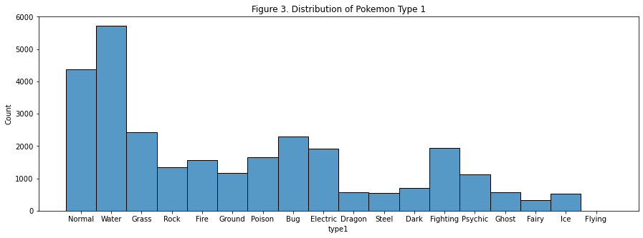
Show the distribution of Pokémon type1
Statistics:
Top 3 common Pokémon type1 are Water, Normal and Grass.
Top 3 rare Pokémon type1 are Flying, Fairy and Ice.

Slide 8
Which Pokémon type1 has the highest/lowest average attack?
Statistics:
Dragon has the highest average attack with the attack value of 116.414802.
Psychic has the lowest average attack with the attack value of 64.123336.
Which Pokémon type1 has the highest/lowest average defense?
Statistics:
Steel has the highest average defense with the defense value of 138.605119.
Normal has the lowest average defense with the defense value of 64.786859.

Slide 9
How many trainers have a full team (6 Pokémon)?
A full team consists of 6 Pokémon that are placed from 0 to 5.
Statistics:
There are 964 trainers with a full team of 6 Pokémon.
How many different teams does Youngster Wyatt have?
What Pokémon has the highest speed on any of his teams?
Statistics:
Youngster Wyatt has 6 different teams.
Tauros has the highest speed among all his pokemon on all the teams.

Slide 10
Which trainer has the most Dragon type Pokémon of level 100? How many level 100 Dragon type Pokémon do they have?
Assume that Pokémon has a Dragon type if type 1 is Dragon because the type1 is dominant feature and type2 is the second feature.
Statistics:
Trainer 4138 (Cooltrainer♂ Forgon) and Trainer 8043 (Myth Trainer Infin) have the most Dragon type Pokémon.
Each of them has 3 Dragon type Pokémon and 6 in total.

Slide 11
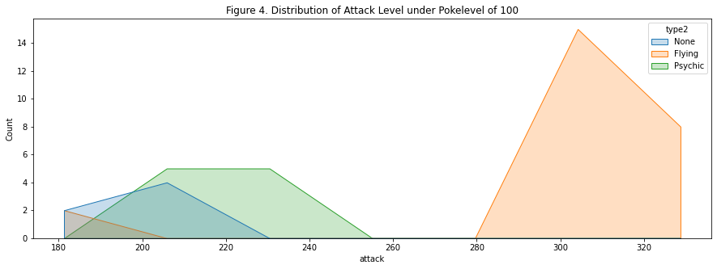
Of the pokelevel 100, which combination of type1 and type2 can bring the dragon Pokémon with the highest attack level?
Known that the dragon type Pokémon brings the highest average attack level, we also would like to know which combination of type1 and type2 can bring the max attack level of dragon Pokémon under the max pokelevel because everyone likes the strongest Pokémon.
Statistics:
The figure shows the strongest dragon Pokémon also has the second feature of flying.

Slide 12
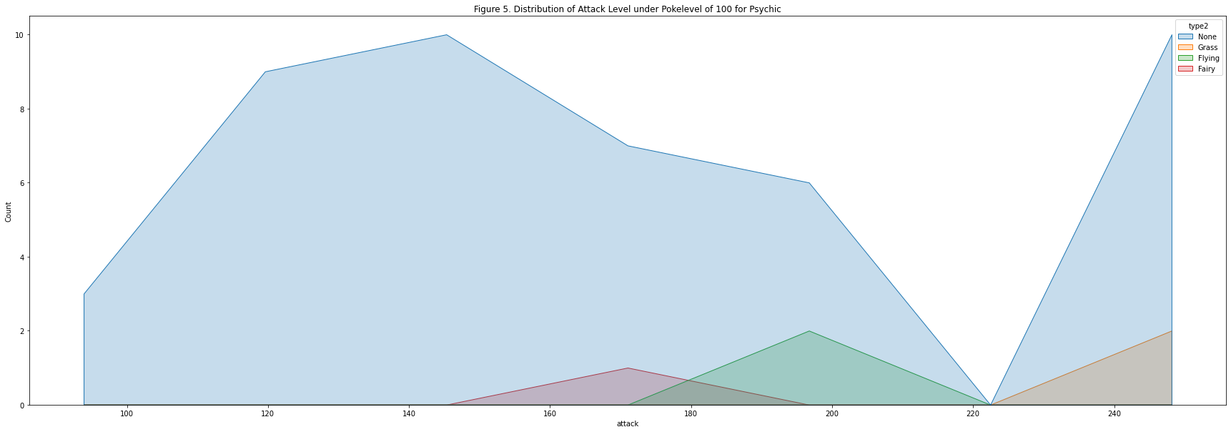
Of the pokelevel 100, which combination of type1 and type2 can bring the Psychic type Pokémon with the highest attack level?
Since we already know the Psychic Pokémon brings the lowest average attack level, we would like to know which Psychic Pokémon that can have the highest attack level under the max pokelevel.
Statistics:
Figure shows the Psychic Pokémon without the second feature and with the second feature of Grass have the max attack level.

Slide 13
Who has the most Pokémon? Please show how many pokemon they have under different type1?
Like holding a Gunnies World Record, it is interesting to look into the data about who has the most Pokémon and how these Pokémon look like.
Statistics:
Cooltrainer♀ Brooke and Cooltrainer♂ Wilton has the most Pokémon, 210 in total per person.
Cooltrainer♂ Brooke has 70 Fire types, 70 Grass types and 70 Water types, and Cooltrainer♂ Wilton has 70 Electric types, 70 Fighting types and 70 Water types.

